Slide 1



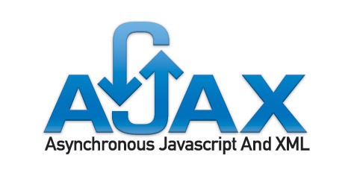
ASP.NET AJAX – Basics
Ventsislav Popov
Crossroad Ltd.

Slide 2


Table of Contents
What is AJAX?
AJAX Concept
ASP.NET AJAX Framework
ASP.NET AJAX Server Controls
ScriptManager, UpdatePanel
Timer, Update Progress
Triggers
ASP.NET AJAX Control Toolkit

Slide 3
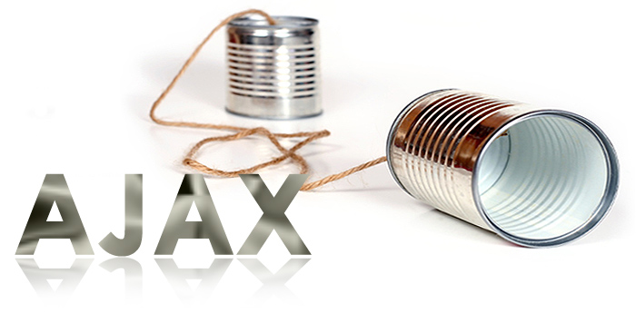
What is AJAX?

Slide 4
What is AJAX?
AJAX = Asynchronous JavaScript And XML
Allows updating parts of a Web page at runtime
Approach for developing dynamic Web sites
Not a particular technology
There are over 50 AJAX frameworks
http://www.maxkiesler.com/index.php/weblog/comments/round_up_of_50_ajax_toolkits_and_frameworks
ASP.NET AJAX is Microsoft’s AJAX framework
Part of ASP.NET and .NET Framework
Supported by Visual Studio
Notes:
AJAX is an acronym that stands for "Asyncronous Javascript And XML". AJAX is a technique, not a product or a brand. AJAX techniques are used to allow a website to communicate with the server without having to load a new page into the browser. By communicating with the server while the page is still loaded, data can be retrieved and dynamically inserted into the existing page.
By allowing a page to communicate with the web server without being reloaded in full, it is possible to create faster and more responsive user interfaces than is possible using the traditional model whereby a new page is loaded with each request by the user.
The term Ajax has come to represent a broad group of web technologies that can be used to implement a web application that communicates with a server in the background, without interfering with the current state of the page
The Microsoft AJAX Library consists of two related parts: JavaScript language extensions and a sort of base class library to provide predefined services and tools to developers. The Microsoft AJAX Library itself is self-contained, written in JavaScript, and stored in a couple of .js files. This means that any programming environment that accepts JavaScript can successfully use the Microsoft AJAX Library provided that the constituent files are properly referenced. There are two main files involved in the Microsoft AJAX Library: MicrosoftAjax.js and MicrosoftAjaxWebForms.js.
What's the benefit of using the Microsoft AJAX Library? The library extends the JavaScript programming environment by adding a number of predefined objects that provide new language features such as namespaces, enumerated types, delegates, stronger typing, and inheritance.

Slide 5
What is AJAX? (2)
AJAX enables you to pass information between a Web browser and Web server without refreshing the entire Web page
Done by asynchronous JavaScript HTTP requests and dynamic page updates
HTTP
Data
(HTML /
JSON /
XML / …)
HTTP
Client Web Browser
Server

Slide 6
AJAX Technology Components
DHTML + DOM
Browser DOM manipulated through JavaScript
Used to dynamically display and interact with the page contents
CSS stylesheets for formatting
XMLHttpRequest object
Exchange data asynchronously with the Web server through asynchronous HTTP requests
Any data format could be used: HTML fragments, text fragments, XML, JSON, etc.
6
Notes:
6
1) The DOM is the data structure your browser uses to record Web pages. Structurally it's a tree of tags, each tag may contain multiple tags below it, corresponding to the format of a HTML (or XML) document. You can use Javascript to examine or change the contents of the DOM dynamically after a page has been loaded -- this is one of the major foundations of AJAX.
2) The XMLHttpRequest object is used to exchange data with a server behind the scenes. The XMLHttpRequest object is a developer's dream, because you can:
Update a web page without reloading the page
Request data from a server after the page has loaded
Receive data from a server after the page has loaded
Send data to a server in the background
1/11/2011 5:39 PM
©2005 Microsoft Corporation. All rights reserved.
This presentation is for informational purposes only. Microsoft makes no warranties, express or implied, in this summary.
6

Slide 7
What is ASP.NET AJAX?
ASP.NET AJAX is AJAX development framework from Microsoft
Standard part of .NET Framework
Allows quickly creating highly interactive Web applications, easy-to-use, highly productive
Supports both popular approaches:
Server-centric (partial page rendering)
Client-centric (client-side control rendering)
Works on all modern browsers: Internet Explorer, Firefox, Safari, Chrome, Opera
7
Notes:
7
ASP.NET AJAX framework provides us with two types of patterns to build richer, more interactive, standards-based Web 2.0 applications: the server-centric programming model and client-centric one. The server-centric programming model enables you to “…modify existing pages at your convenience. In contrast, although the ASP.NET AJAX Client-Centric programming model can leverage full power of client-side JavaScript/XHTML and provide cross-browser richer and more interactive user experience, developers have to spend plenty of time to grasp multifold related techniques of both the server side and the client side
In the “server-centric” approach, you spend your time writing code on the server in your favorite .NET language. During initial page rendering, the server emits markup and JavaScript which is sent to the browser. The JavaScript sent to the browser targets the Ajax Library
Much like the “server-centric” approach, during initial rendering of the page the server emits markup and JavaScript. However, instead of sending data and receiving markup/script to inject into the existing page, the Client Script Libraries then send data and receive data. The Client Script Libraries allow you to make asynchronous calls to web services

Slide 8
ASP.NET AJAX Architecture
XHTML, CSS,
JavaScript,
AJAX
Markup
AJAX-enabled
ASP.NET Pages
Web Services
(ASMX or WCF)
AJAX Client Script Library
ASP.NET AJAX Server Extensions
Controls, Components
App Services Bridge
AJAX
Server Controls
Component Model and UI Framework
Asynchronous Communication
Base Class Library
Script Core Library
ASP.NET 4.0
Page Framework,
Server Controls
Application Services
Browser Compatibility
Client Framework and Services
Server Framework
8
Notes:
8
1) Client components enable rich behaviors in the browser without postbacks. Components fall into three categories:
Components, which are non-visual objects that encapsulate code.
Behaviors, which extend the behavior of existing DOM elements.
Controls, which represent a new DOM element that has custom behavior.
2) The browser compatibility layer provides Microsoft Ajax scripting compatibility for the most frequently used browsers (including Microsoft Internet Explorer, Mozilla Firefox, and Apple Safari). This enables you to write the same script regardless of which supported browser you are targeting
3) In ASP.NET AJAX, the Ajax Server Extensions consists of a powerful set of server controls that simulate Ajax behavior on the client. In other words, these controls do not perform Ajax in its traditional sense (JavaScript calls to a server and dynamic updates with DHTML) but rather in a different way that gives the same illusion to the end user."
4) Ajax server controls consist of server and client code that integrate to produce rich client behavior. When you add an Ajax-enabled control to an ASP.NET Web page, the page automatically sends supporting client script to the browser for Ajax functionality. You can provide additional client code to customize the functionality of a control, but this is not required.
5) The ASP.NET Ajax server extensions framework comprises of the following components:
The Application services bridge - this is used to provide access to the application services that are available as part of the ASP.NET framework
The Web services bridge - this is used to consume external web services from the client side scripts
The ASP.NET Ajax Server Controls - these are server controls provided as part of the ASP.NET Ajax server extensions framework for Ajax support in ASP.NET
1/11/2011 7:45 PM
©2005 Microsoft Corporation. All rights reserved.
This presentation is for informational purposes only. Microsoft makes no warranties, express or implied, in this summary.
8

Slide 9


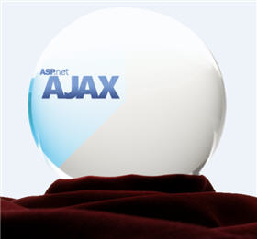
ASP.NET AJAX Server Controls

Slide 10
ASP.NET AJAX Server Controls
ASP.NET AJAX Server Controls allow easily build rich experience with ASP.NET
Application UI and core logic still run on server
Avoid need to master the JavaScript and asynchronous programming
Use AJAX techniques to reduce full round trips
Enable incremental page UI updates
Examples: data navigation and editing, form validation, auto refresh, auto-complete, etc.

Slide 11
ScriptManager Control
<asp:ScriptManager> control
Manages:
AJAX components
Partial page rendering
Client requests and server responses on ASP.NET server pages.
Only one manager control per .aspx page
Automates the JavaScript callbacks
Required once in the page to enable AJAX
Notes:
The ScriptManager control is central to Ajax functionality in ASP.NET. The control manages all ASP.NET Ajax resources on a page. This includes downloading Microsoft Ajax Library scripts to the browser and coordinating partial-page updates that are enabled by using UpdatePanel controls.
2) Partial-Page Rendering - The ability of an ASP.NET page to support partial-page rendering is controlled by the following factors:
The ScriptManager control's EnablePartialRendering property must be true (the default value).
There must be at least one UpdatePanel control on the page.
The SupportsPartialRendering property must be true (the default value). If the SupportsPartialRendering property is not set explicitly, its value is based on browser capabilities.

Slide 12
UpdatePanel Control
<asp:UpdatePanel> control
Easily define "updatable" regions of a page
Implements the server-side AJAX approach (partial page rendering)
Server roundtrips become asynchronous
<asp:UpdatePanel id="UpdatePanelDemo" runat="server">
<ContentTemplate>
<!-- This content can be dynamically updated !->
<asp:Calendar id="CalendarDemo" runat= "server" />
<ContentTemplate>
</asp:UpdatePanel>
Notes:
1) UpdatePanel controls are a central part of AJAX functionality in ASP.NET. They are used with the ScriptManager control to enable partial-page rendering. Partial-page rendering reduces the need for synchronous postbacks and complete page updates when only part of the page has to be updated. Partial-page rendering improves the user experience because it reduces the screen flicker that occurs during a full-page postback and improves Web page interactivity.

Slide 13


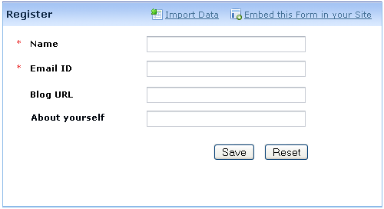

Dynamic Forms with ASP.NET AJAX
Live Demo

Slide 14
UpdatePanel.UpdateMode
UpdatePanel.UpdateMode property:
UpdateMode = Always (default)
Updates the panel for all postbacks that originate from the page (synchronous and asynchronous)
UpdateMode = Conditional
Updates the panel when something inside it is changed (by default ChildrenAsTrigger=True)
Or by calling Update() method explicitly
Or by triggers defined in the update panel
Notes:
When partial-page rendering is enabled, a control can perform a postback that updates the whole page or an asynchronous postback that updates the content of one or more UpdatePanel controls. Whether a control causes an asynchronous postback and updates an UpdatePanel control depends on the following:
If the UpdateMode property of the UpdatePanel control is set to Always, the UpdatePanel control's content is updated on every postback that originates from the page. This includes asynchronous postbacks from controls that are inside other UpdatePanel controls and postbacks from controls that are not inside UpdatePanel controls.
If the UpdateMode property is set to Conditional, the UpdatePanel control's content is updated in the following circumstances:
When you call the Update method of the UpdatePanel control explicitly.
When the UpdatePanel control is nested inside another UpdatePanel control, and the parent panel is updated.
When a postback is caused by a control that is defined as a trigger by using the Triggers property of the UpdatePanel control. In this scenario, the control explicitly triggers an update of the panel content. The control can be either inside or outside the UpdatePanel control that the trigger is associated with.
When the ChildrenAsTriggers property is set to true and a child control of the UpdatePanel control causes a postback. Child controls of nested UpdatePanel controls do not cause an update to the outer UpdatePanel control unless they are explicitly defined as triggers.
The combination of setting the ChildrenAsTriggers property to false and the UpdateMode property to Always is not allowed and will throw an exception.

Slide 15
Triggers
Triggers cause update of the UpdatePanel’s content on particular event
Can be controls inside or outside the panel
<asp:UpdatePanel ID="UpdatePanelWithTriggers"
runat="server" UpdateMode="Conditional">
<Triggers>
<asp:AsyncPostBackTrigger
ControlID="TimerDemo" EventName="Tick" />
</Triggers>
<ContentTemplate>
</ContentTemplate>
</asp:UpdatePanel>
Notes:
1) The Triggers property gets a collection of all the triggers that have been defined for the UpdatePanel control. (You can define triggers declaratively by using the UpdatePanelTrigger Collection Editor dialog box in the designer or by using the <Triggers> element of the UpdatePanel control.) The collection includes AsyncPostBackTrigger and PostBackTrigger objects.
2) Use the AsyncPostBackTrigger control to enable controls to be triggers for an UpdatePanel control. Controls that are triggers for an update panel cause a refresh of the panel's content after an asynchronous postback. Defining an asynchronous trigger control is useful in the following scenarios:
For controls that are outside a panel.
For controls that are inside a panel when the ChildrenAsTriggers property is false.
For controls that are inside nested panels, in order to cause a refresh of parent panels.
3) Use the PostBackTrigger control to enable controls inside an UpdatePanel to cause a postback instead of performing an asynchronous postback.

Slide 16
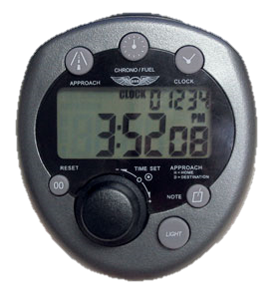

Timer Control
<asp:Timer> control
Added as a trigger of an update panel
Refreshes panel when timer interval expires
<asp:Timer ID="TimerDemo" runat="server" Interval="5000">
</asp:Timer>
Notes:
1) The Microsoft Ajax Timer control performs postbacks at defined intervals. If you use the Timer control with an UpdatePanel control, you can enable partial-page updates at a defined interval. You can also use the Timer control to post the whole page.
2) The Timer control is a server control that embeds a JavaScript component into the Web page. The JavaScript component initiates the postback from the browser when the interval that is defined in the Interval property has elapsed.

Slide 17
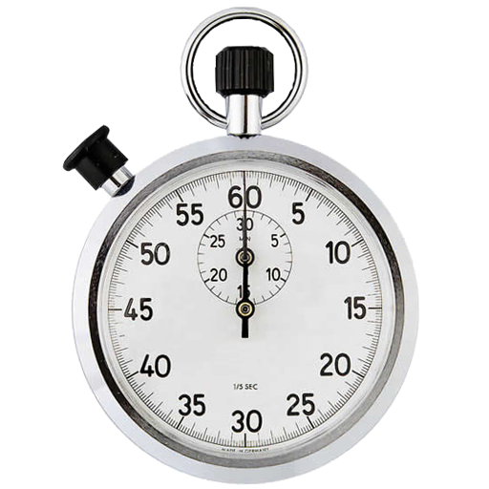

ASP.NET AJAX: UpdatePanel + Timer
Live Demo

Slide 18
UpdateProgress Control
<asp:UpdateProgress> control
Shows status while an asynchronous postback is in progress
Button to cancel the request can be added
<asp:UpdateProgress ID="UpdateProgressDemo"
runat="server">
<ProgressTemplate>
Updating ...
</ProgressTemplate>
</asp:UpdateProgress>
Notes:
1) The UpdateProgress control provides status information about partial-page updates in UpdatePanel controls. You can customize the default content and the layout of the UpdateProgress control. To prevent flashing when a partial-page update is very fast, you can specify a delay before the UpdateProgress control is displayed.

Slide 19
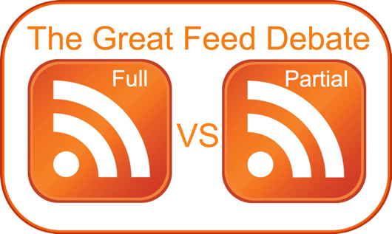

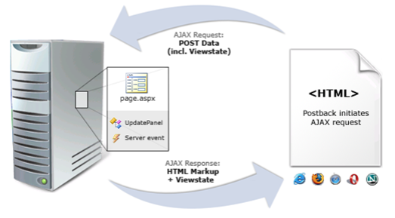


Full vs. Partial Postbacks
Live Demo

Slide 20




ASP.NET AJAX Control Toolkit

Slide 21
ASP.NET AJAX Control Toolkit
Collection of AJAX components
Ready-to-go samples
Comes with full source code and documentation
SDK to simplify the creation and re-use custom AJAX-enabled ASP.NET controls
Some controls:
CascadingDropDown
Link drop-downs, with asynchronous population and no postbacks
21
Notes:
1) The ASP.NET AJAX Control Toolkit is an open-source project built on top of the Microsoft ASP.NET AJAX framework. It is a joint effort between Microsoft and the ASP.NET AJAX community that provides a powerful infrastructure to write reusable, customizable and extensible ASP.NET AJAX extenders and controls.
2) CascadingDropDown is an ASP.NET AJAX extender that can be attached to an ASP.NET DropDownList control to get automatic population of a set of DropDownList controls. Each time the selection of one the DropDownList controls changes, the CascadingDropDown makes a call to a specified web service to retrieve the list of values for the next DropDownList in the set

Slide 22
ASP.NET AJAX Control Toolkit (2)
CollaspiblePanel
Panels that collapse and expand without postbacks
ConfirmButton: extender adding a confirm dialog to any Button, LinkButton, or ImageButton control
DragPanel: makes any panel into an object that you can drag around the page
ModalPopup: shows a modal popup dialog
Home Page: http://asp.net/ajax/ajaxcontroltoolkit/
22
Notes:
1) The CollapsiblePanel is a very flexible extender that allows you to easily add collapsible sections to your web page. This extender targets any ASP.NET Panel control. The page developer specifies which control(s) on the page should be the open/close controller for the panel, or the panel can be set to automatically expand and/or collapse when the mouse cursor moves in or out of it, respectively.
2) ConfirmButton is a simple extender that catches clicks on a button (or any instance of a type derived from Button) and displays a message to the user. If the "OK" button is clicked, the button or link functions normally. If not, the click is trapped and the button will not perform its default submit behavior; optionally, a client script is executed if the OnClientCancel property is set. This is useful for delete links or anything else that requires confirmation from the user.
3) The DragPanel extender allows users to easily add "draggability" to their controls. The DragPanel targets any ASP.NET Panel and takes an additional parameter that signifies the control to use as the "drag handle". Once initialized, the user can freely drag the panel around the web page using the drag handle.
4) The ModalPopup extender allows a page to display content to the user in a "modal" manner which prevents the user from interacting with the rest of the page. The modal content can be any hierarchy of controls and is displayed above a background that can have a custom style applied to it.

Slide 23
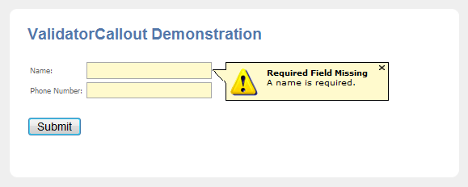
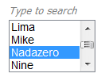
AJAX Control Toolkit
Live Demo

Slide 24



ASP.NET AJAX Basics
Questions?

Slide 25
Exercises
Create an AJAX-enabled Web site which shows Employees among and their Orders in two GridView controls (use the Northwind database and LINQ to SQL.) Put the GridView for the orders inside an update panel. Add UpdateProgress which shows an image while loading (simulate slow loading with Thread.Sleep()).
When the user selects a row in employees GridView, the UpdateProgress must be activated and the panel must be updated with the orders of the selected Employee.

Slide 26
Exercises (2)
Using Timer and UpdatePanel implement very simple Web-based chat application. Use a single database table Messages holding all chat messages. All users should see in a ListView the last 100 lines of the Messages table. Users can send new messages at any time and should see the messages posted by the others at interval of 500 milliseconds.
Using the AJAX Control Toolkit create a Web photo album showing a list of images (stored in the file system). Clicking an image should show it with bigger size in a modal popup window. The album should look like the Windows Photo Viewer.

